Slide 1

LENDING CLUB LOAN STATUS PREDICTION
BY
SAI KUMAR ALE

Slide 2
THIS PRESENTATION What I am going to Cover?
1
2
3
4
5
Introduction
Project Goals
Project Dataset
EDA
&
Machine Learning models
Conclusion
&
References

Slide 3
INTRODUCTION
Banking is one of the important sector in finance as the major portion of monetary assets of people involve banking.
It has large amount of data as everyday new customers, companies, organizations open accounts be it savings or business or current.
Bank data contains information about their users, clients like their balance, history, loan, etc.
Such large amount of data needs to be analyzed for better performance and decision making for banks.
Thus we use machine learning algorithms to do study and analyze and give results for banks to make decisions which optimize their profits.

Slide 4
PROJECT GOALS
Our Project is prediction analysis of Bank data
Bank Marketing is a way to strategize and promote different schemes and benefits of the bank to customers and see which plans give them profit.
Here our project’s goal is to understand how machine learning models can be used in Python Jupyter notebook.
We study different tools of ML and perform prediction of Bank Marketing term deposit

Slide 5
PROJECT DATASET
The Data is from UCI repository and its about Portuguese bank marketing strategy.
It is a survey data and created by making calls to different customers
Here, we have to predict whether a customer will buy the bank’s new term deposit or not
The dataset contains 45211 rows and 17 attributes.
The columns include Age, Job, Marital status, loan, etc. and our target variable is labelled as “y” and it is binary variable with “yes” or “no” values.

Slide 6
DATA CLEANING
Before any analysis, it is important to do preprocessing of the data
This includes cleaning and EDA, it tedious and long process but very crucial as it affects the results.
The data in csv file was not separate in different columns, so when loading in Jupyter notebook, first thing was to separate and create dataframe.
Then we remove the duplicate values and drop the null values.
Dates are changed to individual year, month and day.
Outliers are detected and removed using the inter quartile range.
As there are some columns with character values, we use label encoding to convert them to numbers.

Slide 7
EXPLORATORY DATA ANALYSIS
Exploratory Data Analysis or EDA is about extracting useful information from data.
By using describe command, we get all statistical values like mean, median, mode, etc.
Relation between target variable and different attributes are shown by plots.
The overall pattern of data can be seen

Slide 8
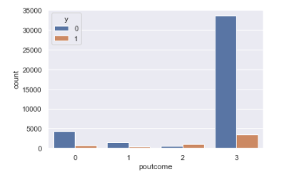
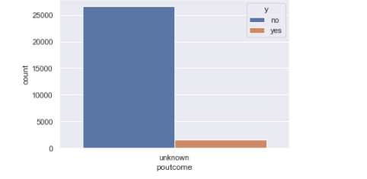
Bar Plot of Previous marketing Campaign
Almost 80 percent of the people who got subscribed for the term in the last campaign falls under the unknown category.
Also most of the people who are not subscribed comes under the same category.

Slide 9
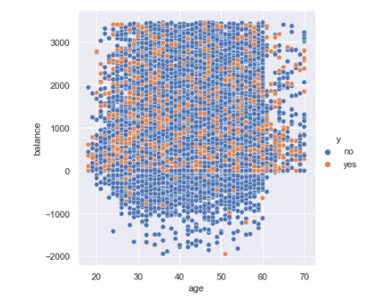
Scatter Plot Between Age and Balance Based on the Subscription
From the graph we can see, the relation between the age and balance is not linear.
People who are maintaining the balance above zero have subscribed for the term deposit.

Slide 10
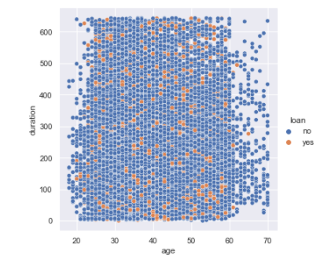
Scatter Plot Between Age and Duration Based on the Subscription
From the graph we can see, the relation between the age and duration is not linear.
The people who got subscribed for the term was dispersed all along the graph irrespective of the call duration.

Slide 11
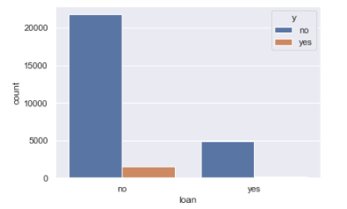
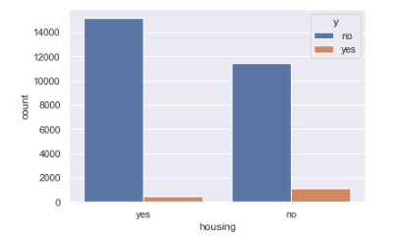
Bar Plot Between Housing loan , loan Based on the Target Variable
In the first graph there is no active loans and not interested to get term deposit.
In second graph, some of the housing loans are active and they have subscribed for term deposit also.

Slide 12
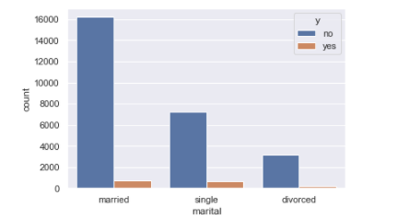
Bar Plot of Marital Status
From this plot, most of the people who got subscribed comes under married which was next followed by Unmarried and Divorced.

Slide 13
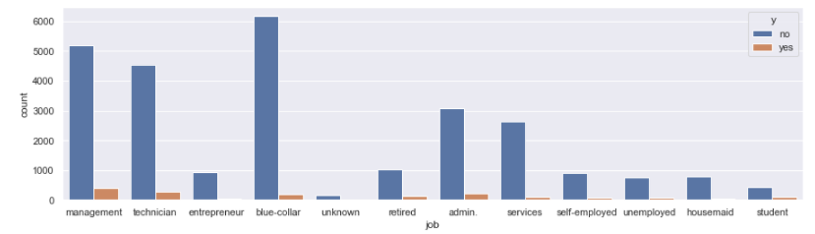
Bar Plot of Job Status
People who are working in a managerial role are interested more in acquiring credit from the bank, which then followed by technicians and admin’s.

Slide 14
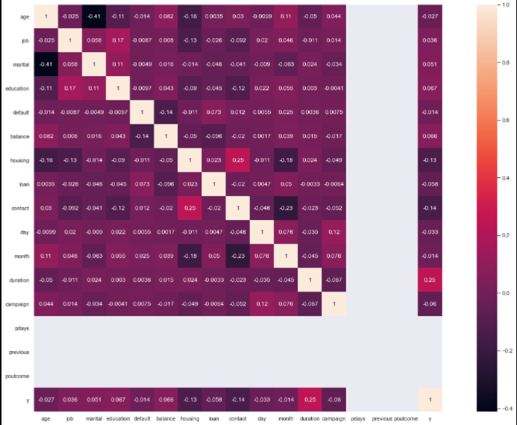
Correlation Plot
This the correlation plot that we have created for the given dataset. As we can see there is no correlation between each other. So, we can safely proceed for further modeling.

Slide 15
MACHINE LEARNING MODELS
We used 5 machine learning models and created the function to call them.
They are Logistic regression, Naïve Bayes, Gaussian model, KNN, Decision Tree, Random Forest
Data is split into 80% training and 20% testing.
After running the models, we find their scores-
Logistic Regression- 94.05% score
Naïve Bayes- 92.17% score
KNN- 94.05% score
ROC of Decision Tree- 66.01%
With this we find that Logistic Regression and KNN are best models for our data

Slide 16
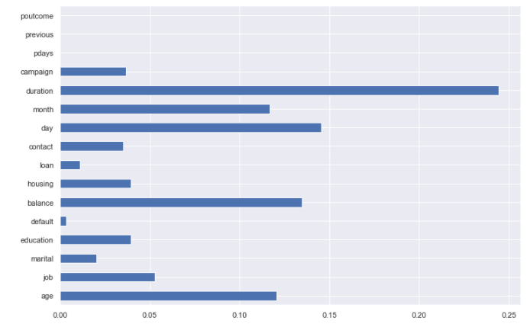
Feature Importance Bar Graph
The first variable we have with more impact on the customers is the duration of the call in seconds, then the next one comes after that is the balance, followed by age and day.

Slide 17
CONCLUSION
The goal of the project was to understand the dataset and implement ML Models in Python which was accomplished.
Highest Accuracy was of Logistic Regression.
The attribute that affects most in duration of the call.
From the EDA and plots, we come to know about the attributes like age, marital status, etc. and which category has highest customers for term deposit.
By analyzing the dataset and using new modeling techniques, the results can be improved more.

Slide 18
REFERENCES
D. and Graff, C. (2019). UCI Machine Learning Repository [http://archive.ics.uci.edu/ml]. Irvine, CA: University of California, School of Information and Computer Science.
[2] Dileep B. Desai, Dr. R.V.Kulkarni “A Review: Application of Data Mining Tools in CRM for Selected Banks”, (IJCSIT) International Journal of Computer Science and Information Technologies, Vol. 4 (2), 2013, 199 – 201. [3] Dr. Madan Lal Bhasin, “Data Mining: A Competitive Tool in the Banking and Retail Industries”, The Chartered Accountant October 2006 23-Sep-17Decision Tree Based Loan Prediction 16

Slide 19
!
THANK YOU

